Slide 1
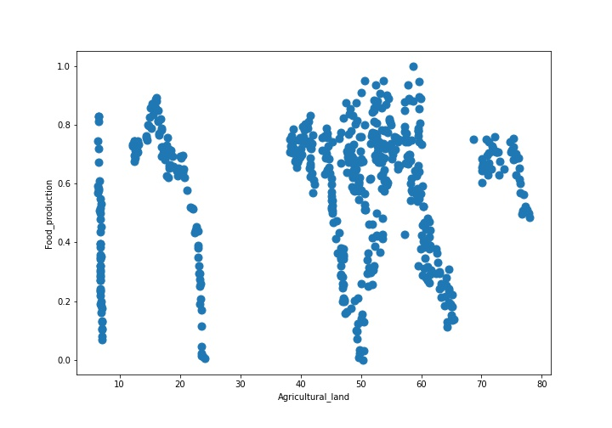
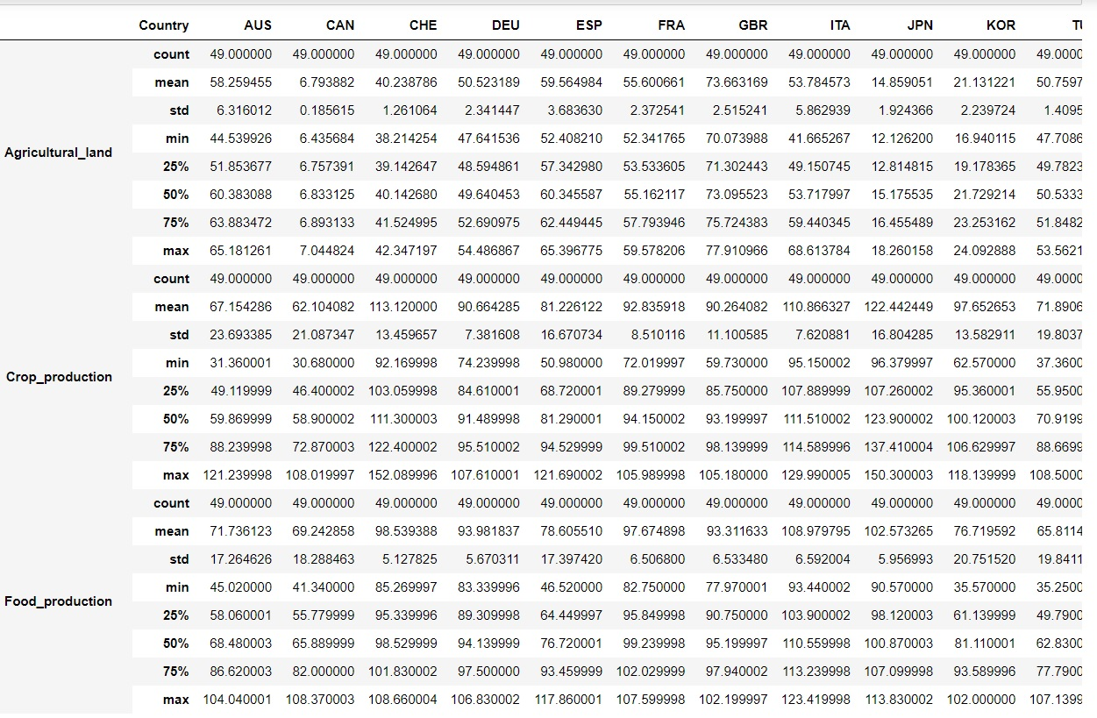
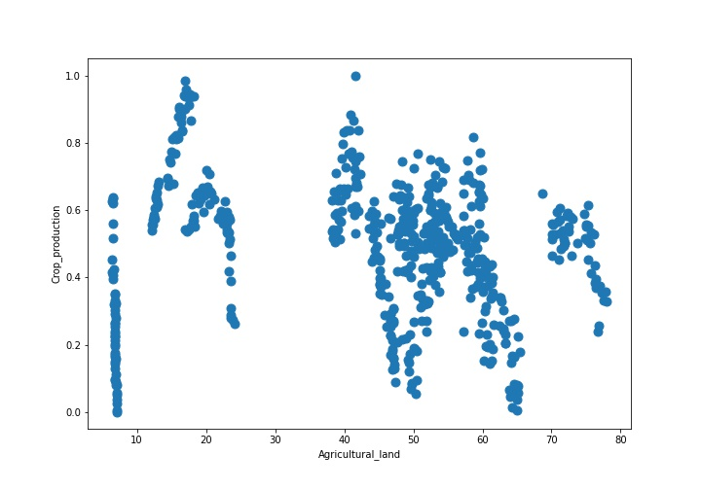
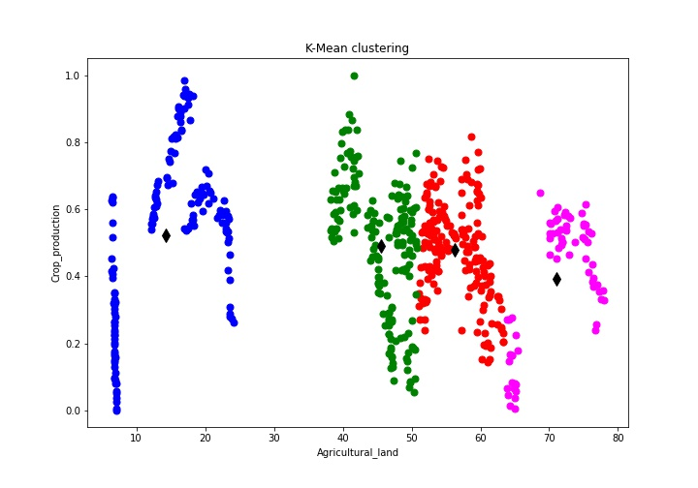
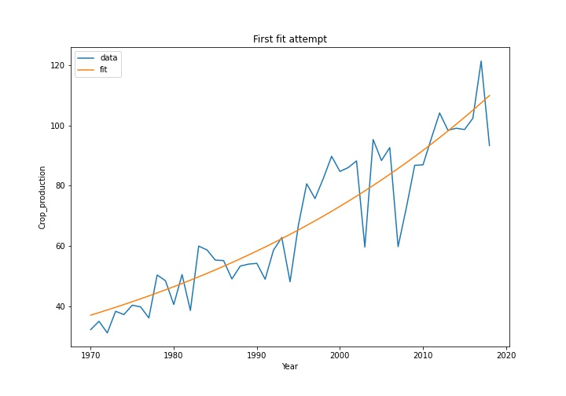
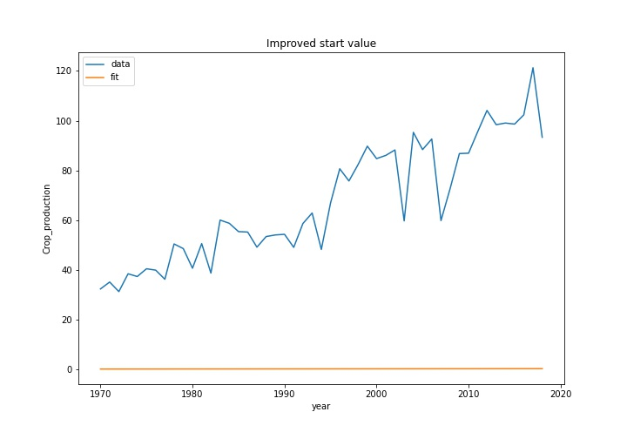
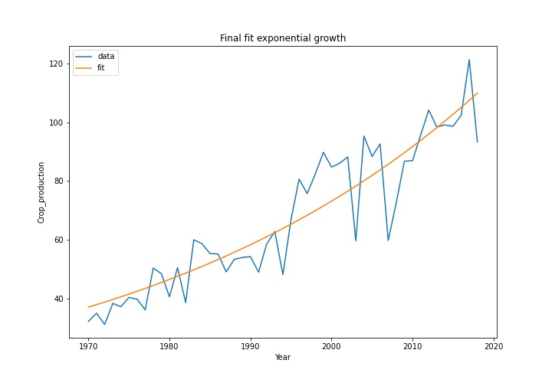
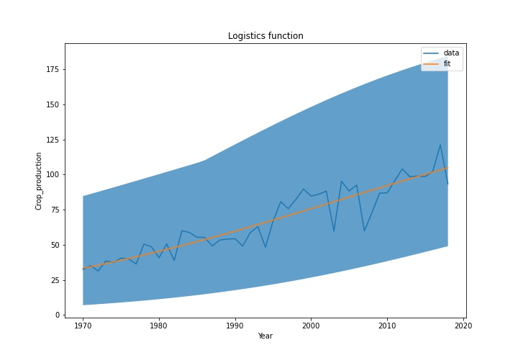
Crops Production’s Visualization, clustering and Predictions
Introduction: I Choose 12 countries from different Continents like north America, Asia and Europe. I want to check which country is good in crop production and which one in food production. So, I access those 12 countries data from year 2070 to 2019 from World bank data and I pick Agricultural land (% of land area) from climate change and other related indicators from different categories. I used following given below indicators.
#Agricultural land (% of land area), Crop production and Food production.
On the Left-hand side, you can see the data frame of 12 countries with agricultural land and their crop and food production values percentage. While on the right-hand side you can see the scattered values of food production over agricultural land.
Visualization
you can see the scattered values of crop production over agricultural land.
Clustering
Data fitting
I used k-Mean Clustering and I picked up two categories like agricultural land and crop production and plot the data. We got the 4 clusters.
I used exponential function and the logistics functions for fitting. In Data fitting I chose the only one country Australia and I display the first fit attempt in it. You can see how crop production value increases or decreases accordingly.
When decrease or increase exponential factor until rough agreement is reached and growth of 0.02 gives a reasonable start value. On the left-hand side that’s the second improved start value plot for crop production while on the right-hand side that’s the final fit exponential crop production
Data Prediction
Forecasted Crop production
2030 between 60.32698741111771 and 199.0963742721422
2040 between 67.83917716206273 and 206.7891088801082
2050 between 74.78712972215187 and 211.66156007700653
Like for 1970 crop production for Australia was like 32% only, for 1990 it was 54% but after data prediction we find out that it could be between 60.32698741111771 and 199.0963742721422 for year 2030.

